Slide 1




Reltio – MDM
Contract overview 7th July 2021
Gerilyn Braglia / Mark B, IT Commercial

Slide 2
Reltio Contract for Master Data Management SaaS
Why Reltio? A BCG study in 2020 identified gaps in National Grid’s control of data and recommended investment in a number of areas including a master data solution.
Reltio has been chosen as the master data management (MDM) solution following a market evaluation and sourcing exercise that looked at the following industry leading products: Reltio, Informatica, Enterworks, and Riversand. Reltio achieved the best combined technical and security results, and with a price $2.6m lower than Informatica, was clearly the best economic choice
What are we going to buy? National Grid is procuring a SaaS MDM solution that will connect data from multiple platforms to create and maintain consolidated master golden data. The system will be configured to support existing UK and US needs with plenty of room for growth. This includes licensing for all needed user roles, supporting Test, Development and Production instances for each of the US and UK.
Service: The service provides 99.95% availability SLAs with service credits for failed SLAs. Support covers both UK and US 9a-5p support
Disaster recovery: Disaster recovery follows ISO 22301 standards, and provides for global redundancy with nodes across a minimum of three cloud zones, including multiple servers within a zone. Data is replicated, load balanced and runs active-active across all zones enabling application and data resilience as well as improved scalability. Reltio’s BCP plan is also ISO22301 compliant with processes that address application & database outages, fires, pandemics, natural disasters & data breaches.
Contract: The terms represent a three year agreement and covers:
Termination for material breach / bankruptcy
Termination for convenience, with the possible responsibility for the full term contract price
Price $2.3m for 3 years (a $1m reduction negotiated against initial proposal)
Price increase capped at 4% for renewal beyond the 36 months
Contract negotiated but not signed

Slide 3
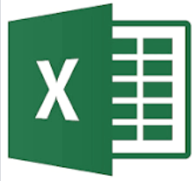

How MDM helps Workforce data domain?
Current State
Future State
Employees & US Contingent Workers
UK Contingent Workers
MSPs
Employees & US Contingent Workers
UK Contingent Workers
MSPs`
MyHub
SAP ECC (UK)
SAP ECC (US)
ACG (UK)
MyHub
SAP ECC (UK)
SAP ECC (US)
ACG (UK)
Master
Transaction
Master Data
Management
Master
MDM
CDP
Data Steward
Lack of single master data source for all workforce, due to multiple source systems
120+ direct interfaces from workforce source systems causing significant impact to business processes and transformational projects such as MyHUB 2.0
Headcount reporting issues across HR and Finance systems
Consolidate master data from multiple source systems
Golden master data record definition will help improve data quality
Reduce complexity for downstream extracts/interfaces
MDM provides ability to create downstream single version of truth for reporting
Legend
Source Systems
Workforce data entry
One directional data flow
Bi-directional data flows
MDM/CDP
Downstream Systems
BI Reports
Extracts

Slide 4

Reltio Contract
Supporting Details

Slide 5
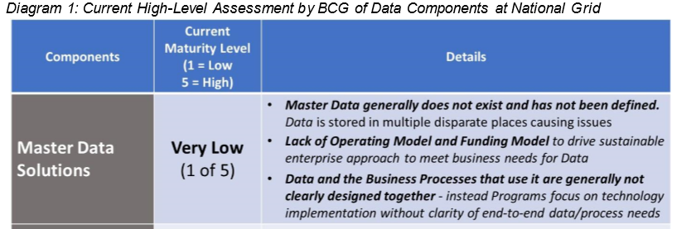
Why Master Data Management (MDM)?
As per the “Fixing Data” paper presented in April 2020 to executives by Chief Data Officer Charles Zentay, unless we “Fix Data” our security, major programs, and financial and operational performance are at risk. The paper was based work by Boston Consulting Group BCG). As per the paper National Grid rates “low” or “very low” across the three major components of Data (Master Data Solutions, Data Governance, and Data Tools & Platforms). BCG’s study, that looked into a subset of the Data domains at National Grid, estimated the costs of bad Data are $73-98M. Given the limited scope of their review, they concluded that the full cost is likely much higher.”
To addresses these issues, we need three key components to “Fix Data”:
Master Data Solutions – for each data domain, establish a data master
Data Governance & Stewardship – Business ownership of data, accelerated by BMS
Data Tools & Capabilities – One, common approach to Enterprise Data solutions

Slide 6
MDM Business Drivers
US Customer Transformation
Domains: Customer B2C, Workforce, Vendor, Product, Reference
FY2022 Business case includes MDM license cost
AMI
Domains: Customer, Asset, Location, Workforce, Reference
Allocated MDM license cost in FY2022 approved budget
Required by Jul 2021
GridMod
Domains: Asset, Location, Workforce, Reference
Allocated MDM license cost in FY2022 approved budget
Required by Jul 2021
IAM
Domains: Workforce, Reference
Workforce Data Domain
Domains: Workforce, Reference
FY2022 Business case has included MDM license cost
Digital Enablement – Leverages / Consumes
Domains: Customer, Workforce, Asset, Location, Reference
Programs: OnMyWay, FutureNow, VMO, Smart Target etc.
RIO based UK-ET and UK-GT initiatives
Domains: Customer B2B, Workforce, Asset, Location, Vendor, Product, Reference
ESO
Domains: Customer B2B, Workforce, Asset, Location, Reference
Energy Efficiency/Clean Energy initiative
Domains: Customer, Workforce, Reference

Slide 7
Vendor Evaluation in detail
Reltio, Informatica, EnterWorks, and Riversand were Evaluated Based on Forrester & Gartner Leaders
Riversand withdrew as they were unable to support Utility business use cases without significant customization
Enterworks had lowest NG user score after their demo
Reltio and Informatica were evaluated on detailed User Scores, Commercials and Security
Reltio received the highest score in the selection process.
Pricing Comparison:
Evaluation Weight Summary |  | Final Score
 |  | Informatica | Reltio
Evaluation Category | Weight
User Score based on Demo | 40% | 32.75 | 30.40
Commercials | 40% | 20.44 | 40.00
Security | 20% | 9.50 | 11.50
Final Score | 100% | 62.70 | 81.90
Year | Informatica BAFO | Reltio BAFO | Cost Difference
Year 1 | $1,674,000 | $514,350 | $1,159,650
Year 2 | $1,674,000 | $870,000 | $804,000
Year 3 | $1,674,000 | $986,250 | $687,750
3 Year Cost | $5,022,000 | $2,370,600 | $2,651,400
Note: Reltio pricing increases to full cost in year 3

Slide 8
What are we buying – Licenses/Services
Reltio is a SaaS solution that connects data across multiple platforms. Included as part of this contract is the Infrastructure to host this application. The Terms include:
60 Million Records
Asset, Location, Customer, Employee, Supplier, Product Domains in US & UK
Production, Test & Dev Environments
22TB of Reltio Storage & 1TB File Storage
1M Data API Calls Daily, 1M Reference Data Management for MDM API Calls Daily, 1M Workflow Processes Annually
30 Data Governance Users, & 60 Casual Users
Address Validation & Location
MuleSoft, Snowflake, D&B Direct+ Connectors; Connected Customer Data for Salesforce
Standard Support – Ability to upgrade if deemed necessary.
Contract Details:
36 Month Term using Reltio’s BAFO (Best & Final Offer) with ramped pricing, covering all US & UK domains Instances
Year | Reltio Original 10M Records for US Only | + Additional 50M Records & UK | Reltio BAFO | Price Difference
Year 1 | $875,000 | $875,000 | $514,350 | ($360,650)
Year 2 | $875,000 | $1,275,000 | $870,000 | ($405,000)
Year 3 | $875,000 | $1,275,000 | $986,250 | ($288,750)
Total | $2,625,000 | $3,425,000 | $2,370,600 | ($1,054,400)
Increased Records from 10 Million to 60 Million Records, covering all of US & UK
Procurement and IT Commercial achieved significant savings with BAFO

Slide 9
Contract Details – Service Levels & Exit Strategy
System Uptime/Availability - 99.95% SLA; Service Credits when SLA not met
Support – Standard Support:
9AM-5PM Local Time; Support for both US & UK in Local Time
ISO 22301 used to structure Business Continuity and Disaster Recover Plans
Platform resilience supported by nodes across a minimum of three cloud zone, with multiple servers within a zone
Encrypted backups maintained for 7 calendar days
Termination for Cause - 90 Day Written Notice Can Terminate For:
Material Breach
If Either Party Ceases Operation
Bankruptcy
Termination for Convenience - 10 Business Days Notice
No Refund of Prepaid Fees
All Payment Obligations Remain
Termination Strategies were negotiated by National Grid’s seasoned legal team

